Slide 1

Clustering
Cluster: a number of things of the same kind being close together in a group
(Longman dictionary of contemporary English
CS240B lecture notes by C. Zaniolo.

Slide 2
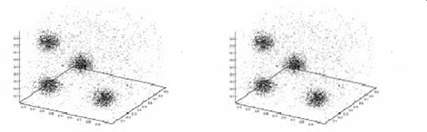
Example: Custormer Segmentation
Given: a Large data base of customer data containing their properties and past buying records:
Find groups of customers with similar behavior (clusters)
Find customers with unusual behavior (outliers)

Slide 3
Problem Definition:
Given a set of N items in D dimensions
Find: a natural partitioning of the data set into a number of clusters (k) + outliers, such that:
  items in same cluster are similar
  ➔ intra-cluster similarity is maximized
  items from different clusters are different
  ➔ inter-cluster similarity is minimized
No predefined classes! Unsupervised Learnig
Used either as a stand-alone tool to get insight into data distribution or as a preprocessing step for other algorithms.

Slide 4
Data Mining:
Concepts and Techniques
— Chapter 7 —
These slides are based on those downloaded from www.cs.uiuc.edu/~hanj
Jiawei Han
Department of Computer Science
University of Illinois at Urbana-Champaign
©2006 Jiawei Han and Micheline Kamber

Slide 5
Clustering: Rich Applications and Multidisciplinary Efforts
Pattern Recognition
Spatial Data Analysis
  Create thematic maps in GIS by clustering feature spaces
  Detect spatial clusters or for other spatial mining tasks
Image Processing
Economic Science (especially market research)
WWW
  Document classification
  Cluster Weblog data to discover groups of similar access patterns

Slide 6
Examples of Clustering Applications
Marketing: Help marketers discover distinct groups in their customer bases, and then use this knowledge to develop targeted marketing programs
Land use: Identification of areas of similar land use in an earth observation database
Insurance: Identifying groups of motor insurance policy holders with a high average claim cost
City-planning: Identifying groups of houses according to their house type, value, and geographical location
Earth-quake studies: Observed earth quake epicenters should be clustered along continent faults

Slide 7
K-Means
K-means (MacQueen, 1967) is one of the simplest clustering algorithms to minimize distance from centers.
Place K points into the space represented by the objects that are being clustered. These points represent initial group centroids.
Assign each object to the group that has the closest centroid.
When all objects have been assigned, recalculate the positions of the K centroids.
Repeat Steps 2 and 3 until the centroids no longer move. This produces a separation of the objects into groups from which the metric to be minimized can be calculated.

Slide 8
K-means example, step 1
k₁
Y
Pick 3
initial
cluster
centers
(randomly)
k₂
k₃
X

Slide 9
K-means example, step 2
k₁
Y
k₂
Assign
each point
to the closest
cluster
center
k₃
X

Slide 10
K-means example, step 3
k₁
k₁
Y
Move
each cluster center
to the mean
of each cluster
k₂
k₃
k₂
k₃
X

Slide 11
K-means example, step 4
Reassign
points
closest to a different new cluster center
Q: Which points are reassigned?
k₁
Y
k₃
k₂
X

Slide 12
K-means example, step 4
Reassign points
to the closest center
Q: points reassigned:
k₁
Y
k₃
k₂
X

Slide 13
K-means example, step 5
k₁
k₁
Y
re-compute cluster means
k₂
k₃
k₂
k₃
X

Slide 14
K-means example, step 6
Reassign points to clusters:
No change:
The end
k₁
Y
k₂
k₃
X

Slide 15
K-means clustering summary
Advantages
Simple, understandable
items automatically assigned to clusters
Disadvantages
Must pick number of clusters before hand
All items forced into a cluster
Too sensitive to outliers

Slide 16
Similarity and Distance
K-means and all methods group together the most similar objects
Where some notion of distance is used to define similarity
  Close-by, i.e., similar
  Far apart, i.e. dissimilar
Distance obvious in our XY planes, not so obvious in general: categorical, boolean, vectors, etc.

Slide 17


Dissimilarity between Items is expressed by their Distance
Data matrix
  No assumption
Typical Symmetric
matrix

Slide 18
Type of data in clustering analysis
Interval-scaled variables
Binary variables
Nominal, ordinal, and ratio variables
Variables of mixed types

Slide 19
Interval-Scaled Variables
Interval-scaled are continuous measurements in roughly linear scale—e.g., temperature, weight, coordinates—which are then assumed to range over an interval.
Notion of Distance between two vectors:
X=<x₁,…,x_{n}> and Y=<y₁,…,y_{n}>:
(|x₁-y₁|^{q} + … + |x_{n}-y_{n}|^{q})^{1/q}
  q=2: Euclidean distance
  q=1: Manhattan distance
  1<q<2: Minkowski distance

Slide 20
Metric Properties
  Are satisfied by all three previous distances:
    d(i,j) ≥ 0
    d(i,i) = 0
    d(i,j) = d(j,i)
    d(i,j) ≤ d(i,k) + d(k,j)

Slide 21
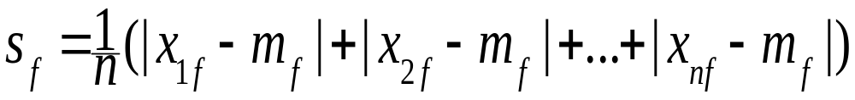
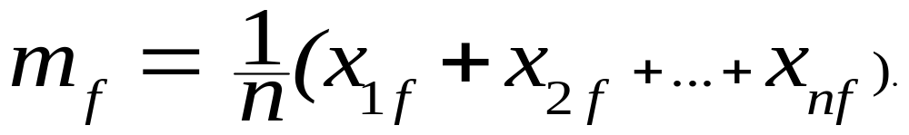
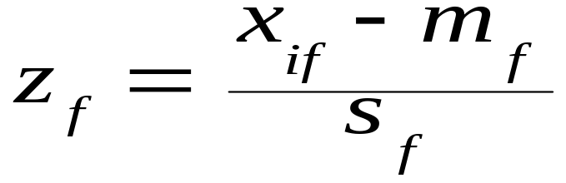
Heterogeneous Variables
Standardization is needed: E.g. if have n values for x
  Calculate the mean absolute deviation:
  w.r.t. the mean:
  Calculate the standardized measurement (z-score)
Using mean absolute deviation is more robust than using standard deviation

Slide 22
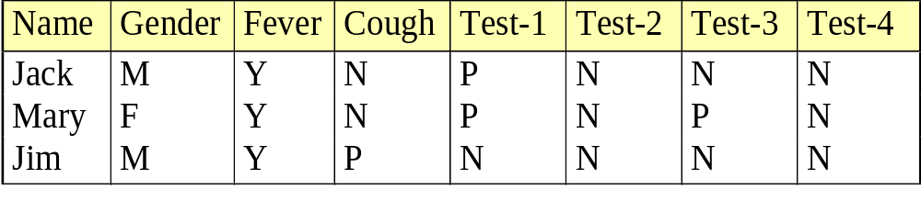
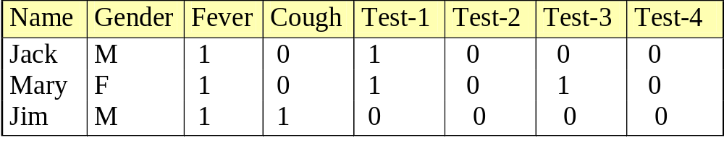
Dissimilarity between Binary Variables
Example
  gender is a symmetric attribute
  the remaining attributes are asymmetric binary (0 denotes normal condition)
  let the values Y and P be set to 1, and the value N be set to 0

Slide 23
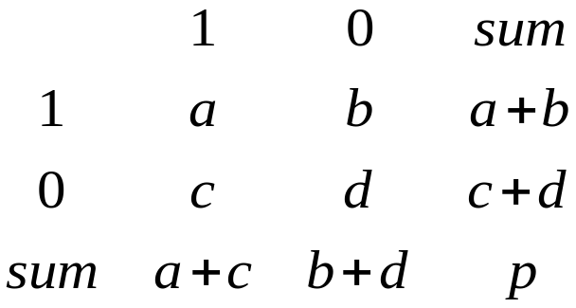


Binary Variables—vector of size p
Object j
A contingency table for binary data
Distance measure for symmetric binary variables:
Object i

Slide 24
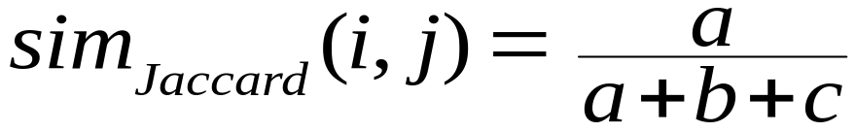
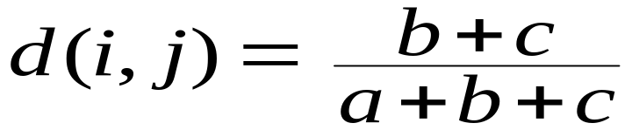
Binary Variables—vector of size p
Object j
A contingency table for binary data
Distance measure for symmetric binary variables:
Jaccard coefficient (similarity measure for asymmetric binary variables):
Distance measure for asymmetric binary variables.
[1-sim]
Object i

Slide 25
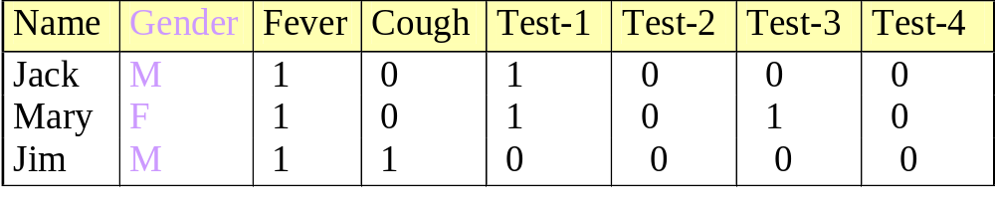

Dissimilarity between Binary Variables
Example
  gender is a symmetric attribute
  the remaining attributes are asymmetric binary
  dissimilarity for asymmetric attribute only

Slide 26

Categorical Variables
A generalization of the binary variable in that it can take more than 2 states, e.g., red, yellow, blue, green
Method 1: Simple matching
  m: # of matches, p: total # of variables:
Method 2: use a large number of binary variables
  creating a new binary variable for each of the M nominal states

Slide 27


Ordinal Variables
An ordinal variable can be discrete or continuous
Order is important, e.g., rank
Can be treated like interval-scaled
  replace x_{if} by their rank
  map the range of each variable onto [0, 1] by replacing i-th object in the f-th variable by
  compute the dissimilarity using methods for interval-scaled variables

Slide 28
Ratio-Scaled Variables
Ratio-scaled variable: a positive measurement on a nonlinear scale, approximately at exponential scale, such as Ae^{Bt} or Ae^{-Bt}
Methods:
  treat them like interval-scaled variables—not a good choice! (why?—the scale can be distorted)
  apply logarithmic transformation
y_{if} = log(x_{if})
  treat them as continuous ordinal data treat their rank as interval-scaled

Slide 29
Combining Variables of Mixed types
Bring all the variables into a common scale—typically ranging between 0 and 1.

Slide 30


Vector Objects
Vector objects: keywords in documents, gene features in micro-arrays, etc.
Broad applications: information retrieval, biologic taxonomy, etc.
Cosine measure
A variant: Tanimoto coefficient (for binary)

